Slide 1
Harmony High School
2021-2022 Senior Parent Night Presentation

Slide 2
Administration
Principal: Mr. Hickey
Assistant Principal: Dr. Carroll
Assistant Principal: Dr. Harris
Assistant Principal: Mrs. Yontz

Slide 3
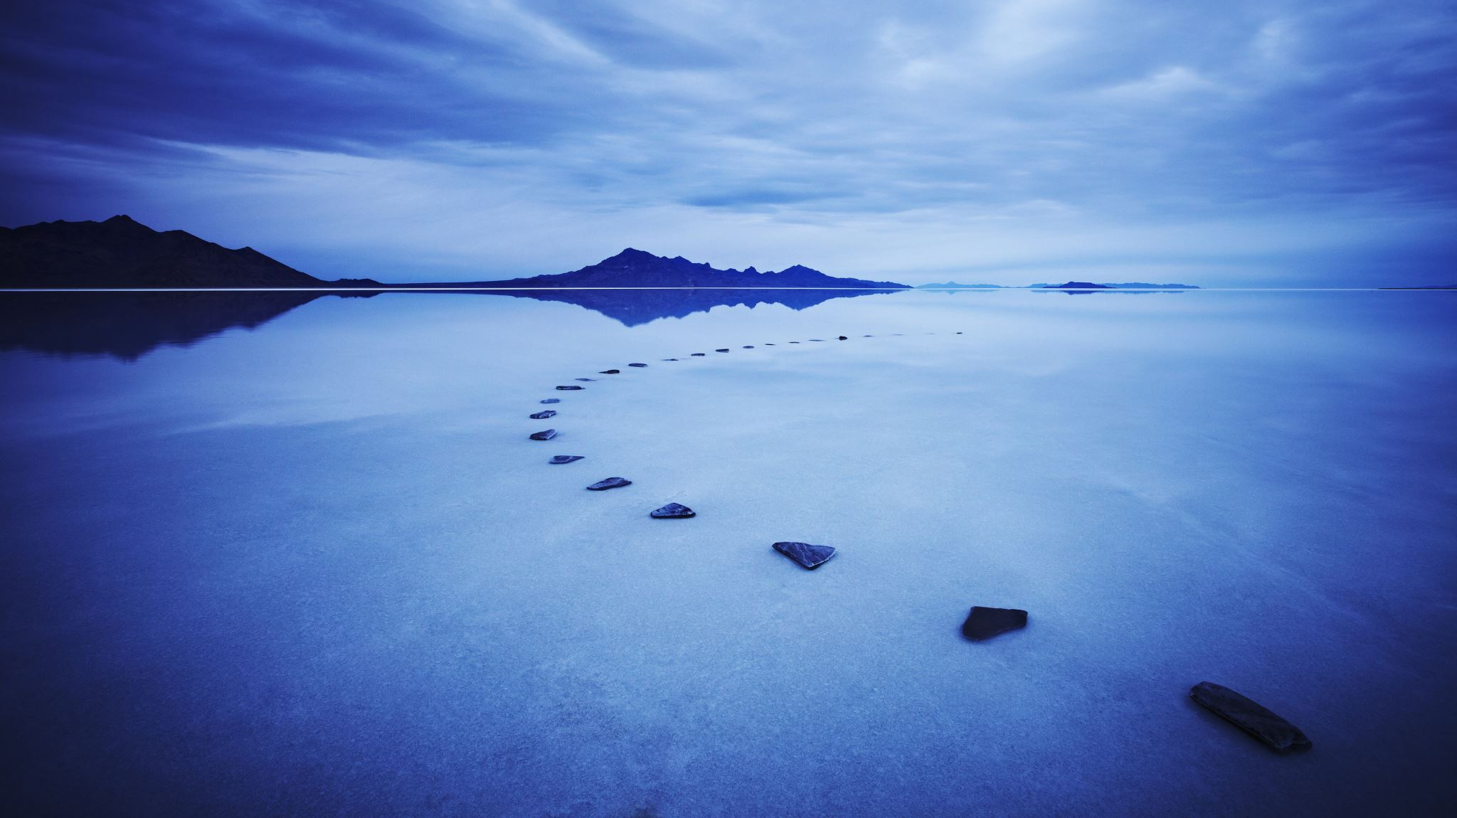
Guidance

Slide 4
GUIDANCE
Who do I see?
Mrs. Spitaliere Alexandra.Spitaliere@osceolaschools.net A-EG
Ms. Yaeger Madison.Yaeger@osceolaschools.net EH-LT
Mrs. Hetherly Deana.Hetherly@osceolaschools.net LU-ROC
Mrs. Merced (Carrasquillo) Angelina.Merced@osceolaschools.net ROD-Z
Mrs. Barton Cathy.Barton@osceolaschools.net College/Career
Mrs. Tattoli Amanda.Tattoli@osceolaschools.net Valencia Coach
Ms. Smith LaKaysia.Smith@osceolaschools.net Social Worker

Slide 5
Graduation Requirements
Credits
GPA – 2.0 unweighted or higher
Testing
Algebra 1 EOC (3 or higher)
FSA ELA (3 or higher on 10th grade test)
Geometry, Biology & U.S. History EOC (30% of final grade)
Concordant Scores
SAT Math 420, PSAT Math 430, ACT Math 16
SAT English/Reading 480 or ACT Reading & English Avg 18
4 English
4 Math (Algebra 1, Geometry & Higher)
3 Science (Biology & 2 others)
1 World History
1 U.S. History
.5 Economics (1 semester)
.5 U.S. Government (1 semester)
1 PE (Semester of Personal Fitness & PE Elective)
1 Fine or Practical Arts Class
8 Electives (including 1 Virtual School Class)
*Senior Credit Checks Will Begin Oct. 4th

Slide 6
GUIDANCE
Need HHS info???
Sign Up for
Freshmen text @25harmony to 81010
Sophomores text @24harmony to 81010
Juniors text @23harmony to 81010
Seniors text @harmony22 to 81010

Slide 7
Senior School Day SAT
October 13, 2021
Students registered by district
Free

Slide 8
College Applications
Institution Application
Found on Admissions Page of Each Website
Common Application
www.commonapp.org
Must Link to Xello (See Mrs. Barton for Help)
Coalition
www.coalitionforcollegeaccess.org

Slide 9
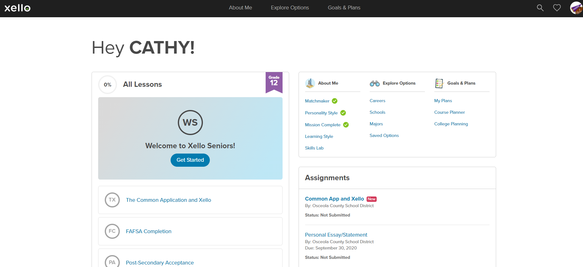
GUIDANCE

Slide 10
College Application Deadlines
4-Year Universities – Nov. 1st
Merit Scholarship $
Fall Term Seats Fill Quickly
Everyone Applies First Time in College Freshman
Regular Decision, Early Action, Early Decision, Rolling
2-Year and Technical Colleges – Jan. 1st
Allows Time to Submit Required Documents

Slide 11
DE/AA Reminders
*If you graduate with AA, you are not a Direct Connect to UCF
*All DE students apply as 1st time Freshman & considered as a Freshman first then as a Transfer student second
*DE continuing at Valencia, must do Change of Major form in Atlas in January to switch from non-degree seeking to degree seeking. You will also need to provide Florida Residency documentation.

Slide 12
Military Enlistment
Air Force, SSGT Martinez, 321-403-1029
Army, SSGT Grippin, 813-785-9086
Coast Guard,
Marine Corps, SSGT Grimaldi, 321-436-0490
National Guard, SSGT Jimenez, 407-271-9669
Navy, Petty Officer Gibbs, 407-840-2580

Slide 13
ASVAB Testing
September 30, 2021
Students register with QR Code
Free
Juniors & Seniors Only

Slide 14
Paying For College
Bright Futures
Application opens Oct. 1st
Do not need to qualify to apply
Can only be used for schools in Florida
FAFSA
Application for Fall/Spring Term opens Oct. 1st
Application for Summer Term 21-22 open now
Scholarships
Local
Education Foundation opens Nov 1st
Additional ones in Xello, Sr Teams, Remind
National
GoingMerry.com
Scholarships.com
College Board Educational Opportunity
Xello

Slide 15
GUIDANCE

Slide 16
1st Semester Senior Events
Sept. 15th – Spring DE Application opens
Sept. 30th – ASVAB (students sign up with QR Code)
Sept. 27th – Oct. 1st – College Week (themed days)
Oct. 1st – Bright Futures Application & FAFSA opens
Oct. 6th – College/Career Fair 8-1:20 in the Gym
Oct. 13th – Sr School Day SAT
Oct. 15th – DE Application closes
Oct. 20th – Math PERT for DE
Oct. 21st – Reading/Writing PERT for DE
Oct. 22nd – Homecoming Game
Oct. 23rd – Homecoming Dance
Oct. 26th – Cap/Gown Ordering Presentation 3rd Per. In Auditorium

Slide 17
2nd Semester Senior Events
April 9th – Prom
April – Cap/Gown Distribution
April 29th – Decision Day Celebration
April 30th – Grad Bash at Universal
May – Top 100 College Acceptance District Ceremony
- Senior Academic Awards Ceremony
- Graduation

Slide 18
Senior Yearbook Deadlines
Oct. 15th – Sr Picture Deadline
Oct. 20th – Sr Baby Pictures email to
nalani.simon@osceolaschools.net
Dec. 3rd – Sr Ads can be purchased at
Jostens.com

Slide 19
Thank you
Have a great school year!!

